Slide 1
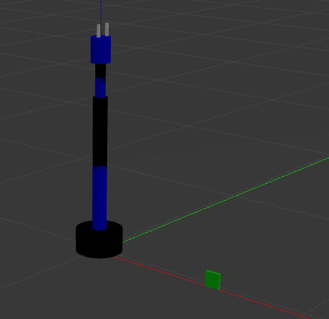

21AIE213 Robotic Operating Systems Project
By
Group-27

Slide 2
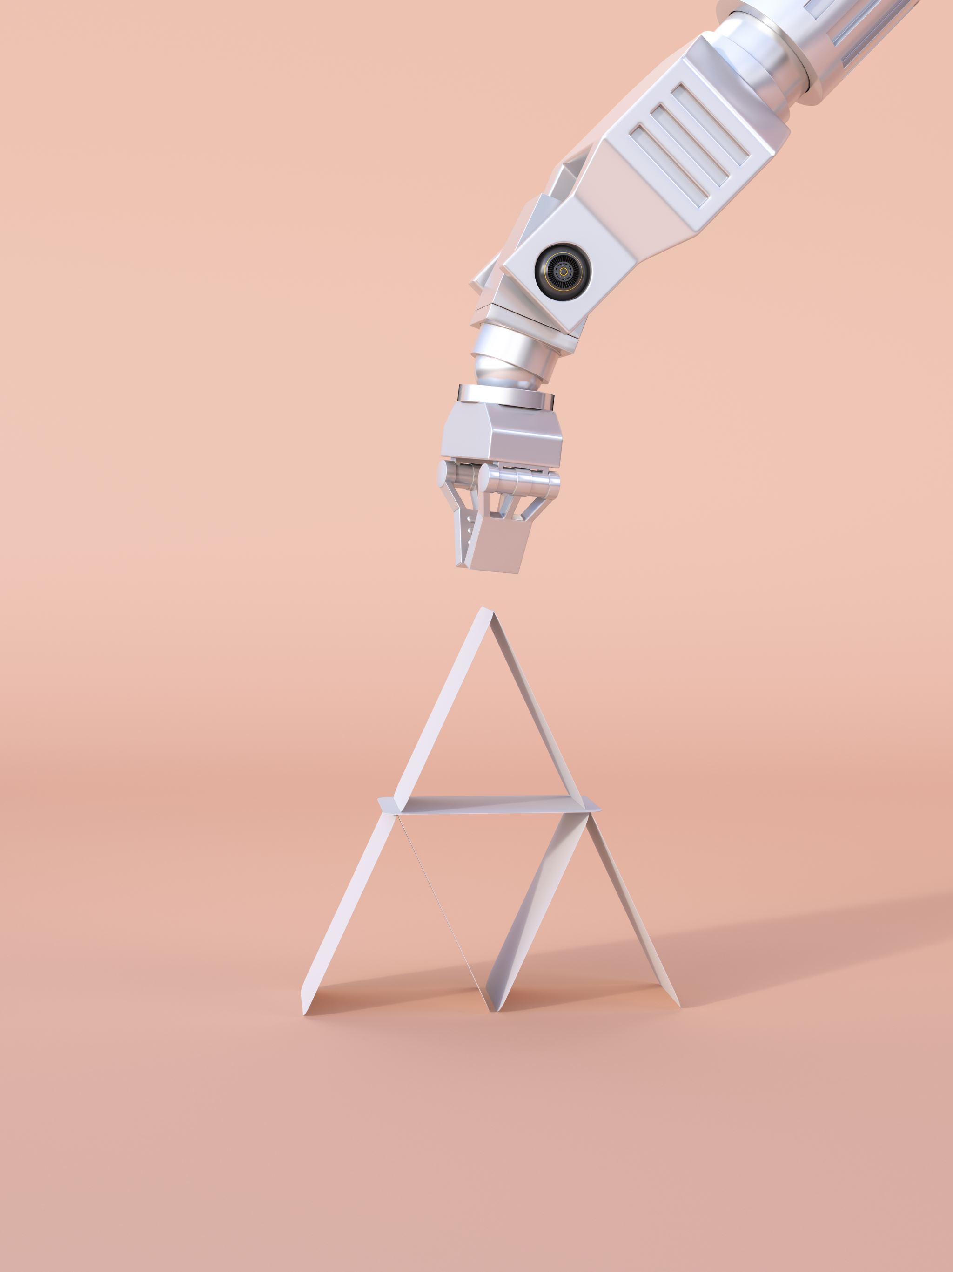
PICK AND PLACE ROBOTIC ARM (Motion Planning)
Under the supervision of
Prof. Sajith Variyar

Slide 3
Team Members
Menta Sai Akshay [CB.EN.U4AIE20040]
Sai Aravind V [CB.EN.U4AIE20062]

Slide 4

Why This Robot?
To reduce human effort in industries
To make a manual to automation
To increase a Productivity
To increase a cycle time

Slide 5
Introduction
Pick And Place Robot is a mechatronic system that picks object from source location and places at desired location.
Here, we are providing every information about where the object is present in the world and how every joint should move to pick that object. As soon as robot picks it with end effectors, we are giving the co-ordinates of a point where that object should be placed.
If another object causes interrupt, it again does the same job. Whole process is controlled by micro controller.

Slide 6

Different Parts of Pick and Place Robot
A pick and place robot has several dedicated parts, such as:​
Robot Arm tool:
A robotic arm, also known as a manipulator, is the extension of the robot by using cylindrical or spherical parts. links, and joints.​

Slide 7
​
End Effector:
The end effector is the accessory at the end of the robotic arm, that does the required job such as gripping objects. The end effectors can be designed to perform different functionalities based on requirements.
Actuators:
Actuators create the motion in the robotic arm and end effectors. The linear actuators are basically any type of motor, such as servo motor, stepper motor, or hydraulic cylinder.​
​
Controllers:
Controllers synchronize and control the movement of different actuators of a robot, thereby being the brain behind the smooth robotic operation.​
​

Slide 8
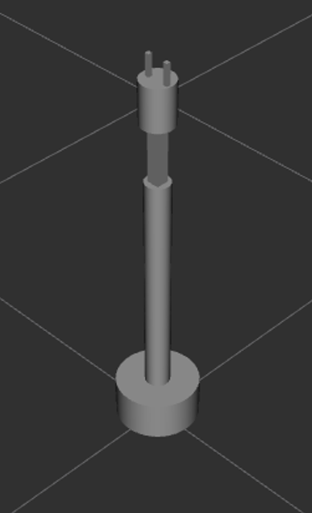
Working
The basic function of a pick and place robot is done by its joints. Joints are analogous to human joints and are used to join the two consecutive rigid bodies in the robot. They can be rotary joint or linear joint.
To add a joint to any link of a robot, we need to know about the degrees of freedom and degrees of movement for that body part.

Slide 9
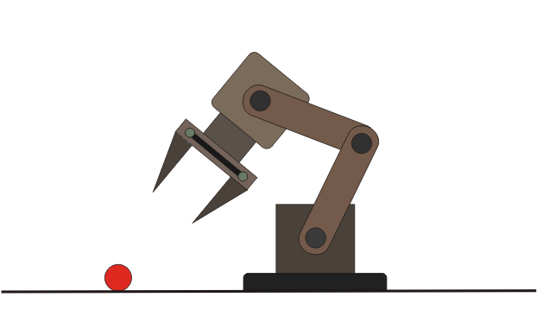
Working
Degrees of freedom implement the linear and rotational movement of the body and Degrees of movement imply the number of axis the body can move​.
​A simple pick and place robot consists of two rigid bodies on a base, connected with rotatory joint. A rotatory joint is one which provides rotation in 360 degrees around any one of the axes.
The bottom or the base is attached to the ground.

Slide 10
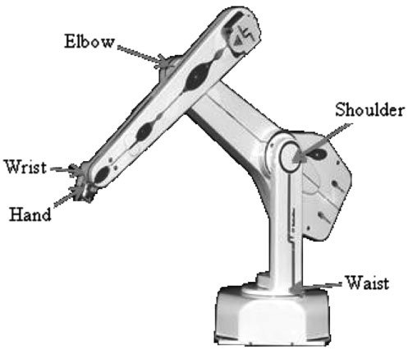
Working
The 1st rigid body is fixed and supports the second rigid body to which the end effector is provided.
The 2nd rigid body is provided with movement in all 3 axes and has 3 degrees of freedom. It is connected to the 1st body with a rotational joint.
The end effector should accommodate all 6 degrees of freedom, to reach all sides of the component, to take up position to any height.

Slide 11
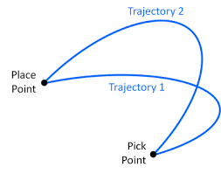
Hierarchy of motion Planning
Task planning – Designing a set of high-level goals, such as “go pick up the object in front of you”. ​
Path planning – Generating a feasible path from a start point to a goal point. A path usually consists of a set of connected waypoints. ​
Trajectory planning – Generating a time schedule for how to follow a path given constraints such as position, velocity, and acceleration. ​
Low level control – Once the entire trajectory is planned, there needs to be a control system that can execute the trajectory in a sufficiently accurate manner. ​

Slide 12
TRAJECTORY PLANNING
Trajectory: Time evolution of position, velocity and acceleration.
1
Given a change in the end effector position, a smooth transition from initial to the final pose of the end effector is required. This is achieved by change in joint angles, velocity and acceleration.
2
Inverse Kinematics gives change in joint variable. When the additional dimension of time is incorporated, velocity and acceleration of each joint can be found.
3

Slide 13
Types of Trajectory Function
There are various ways to create trajectories that interpolate pose (or joint configurations) over time.
Trapezoidal Velocity trajectory
Trapezoidal velocity trajectories are piecewise trajectories of constant acceleration, zero acceleration, and constant deceleration. This leads to a trapezoidal velocity profile, and a “linear segment with parabolic blend” (LSPB) or s-curve position profile.
This parameterization makes them relatively easy to implement, tune, and validate against requirements such as position, speed, and acceleration limits.

Slide 14
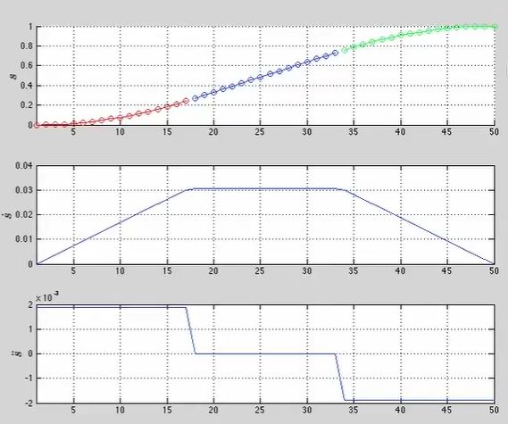

Slide 15
2. Polynomial Trajectory​
We can interpolate between two waypoints using polynomials of various orders. ​
Cubic (3rd order) – Requires 4 boundary conditions: position and velocity at both ends​
Quintic (5th order) – Requires 6 boundary conditions: position, velocity, and acceleration at both ends​

Slide 16
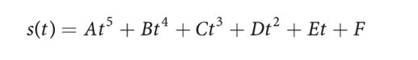
Trajectory Planning
The trajectory has defined boundary conditions for position, velocity and acceleration and frequently the velocity and acceleration boundary conditions are all zero
We have 6 constraints
So, we use quintic polynomial

Slide 17
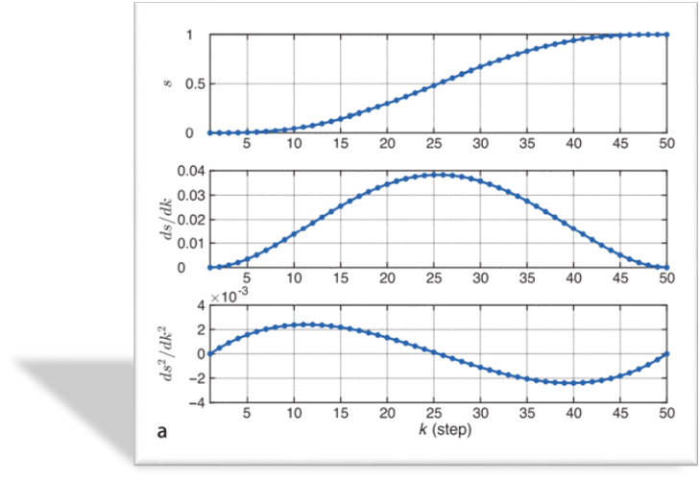
Graph of displacement velocity and acceleration of end effector using quintic polynomial​

Slide 18
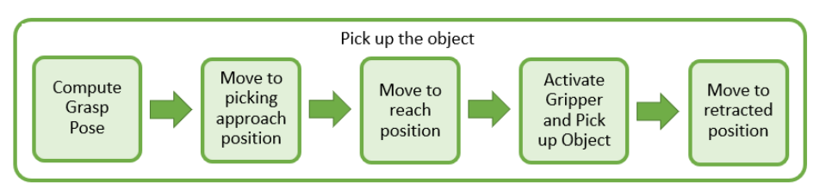
Flow Chart
Once the waypoints are guaranteed to be collision free, they can be passed on to the trajectory processing module. This module adds timing information to the different waypoints such that we are not only aware of where we should be but also at what times should we be at each waypoint.
In essence, velocity and acceleration information is appended to the waypoints so that, the desired motions can be executed on a robot.

Slide 19
Robotic Arm in URDF

Slide 20
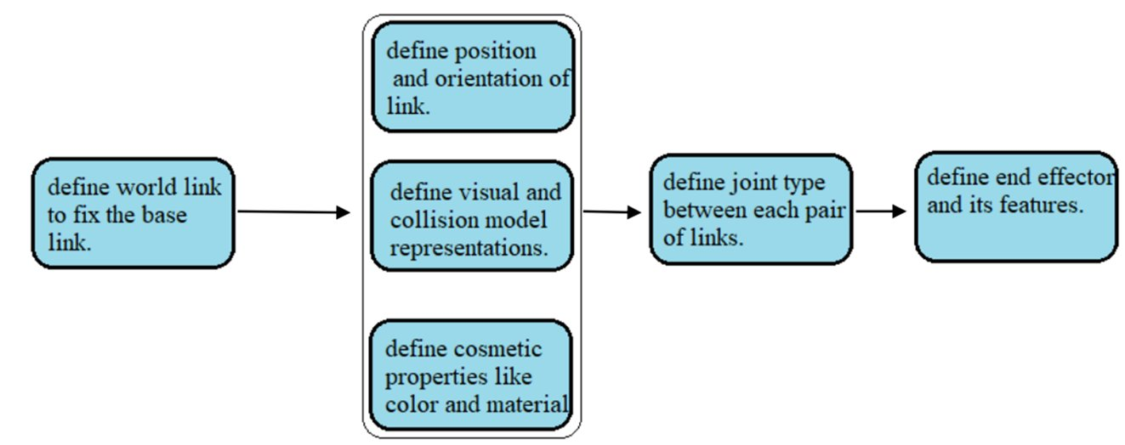
Steps

Slide 21
6-DOF Robotic Arm in Gazebo

Slide 22
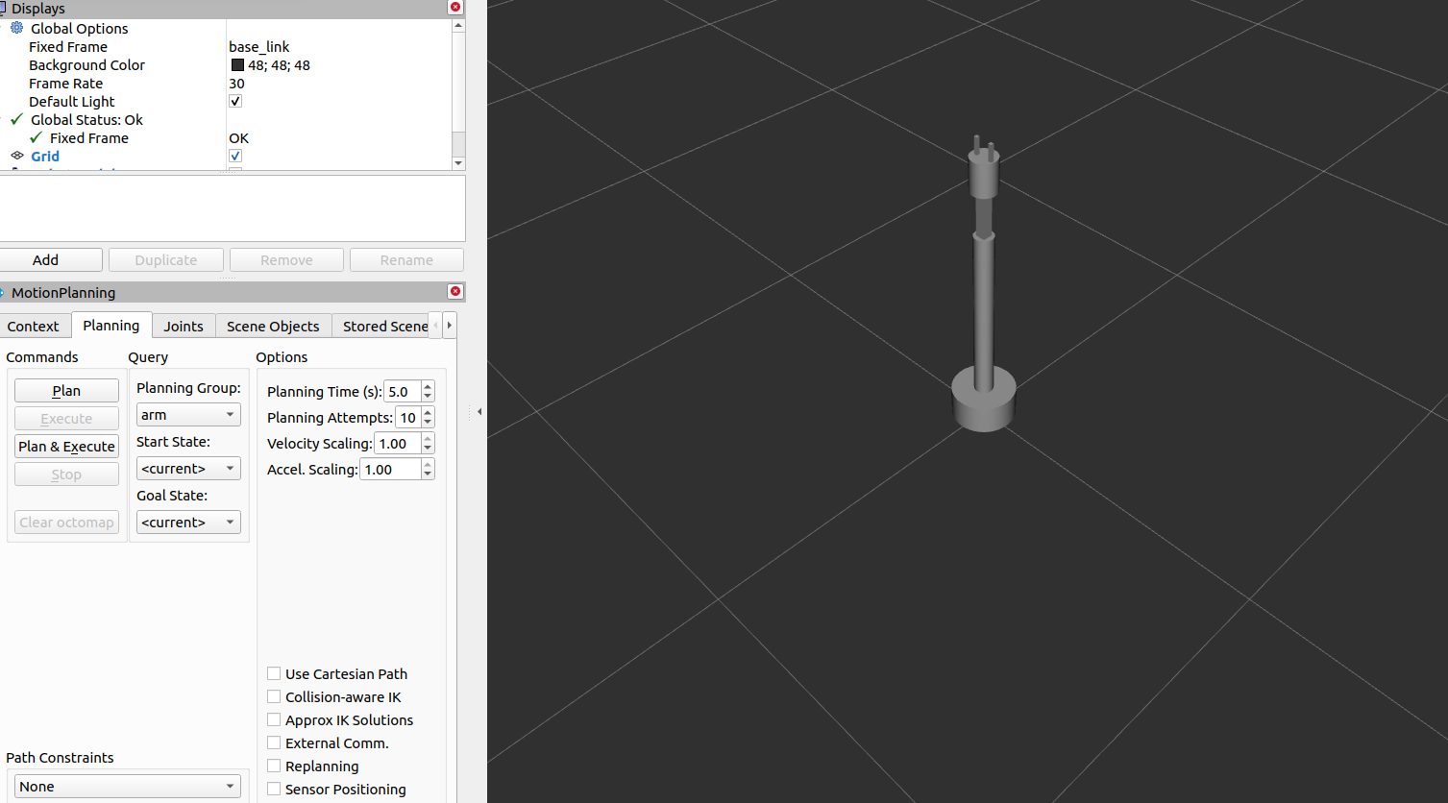
6-DOF Robotic Arm in Rviz

Slide 23
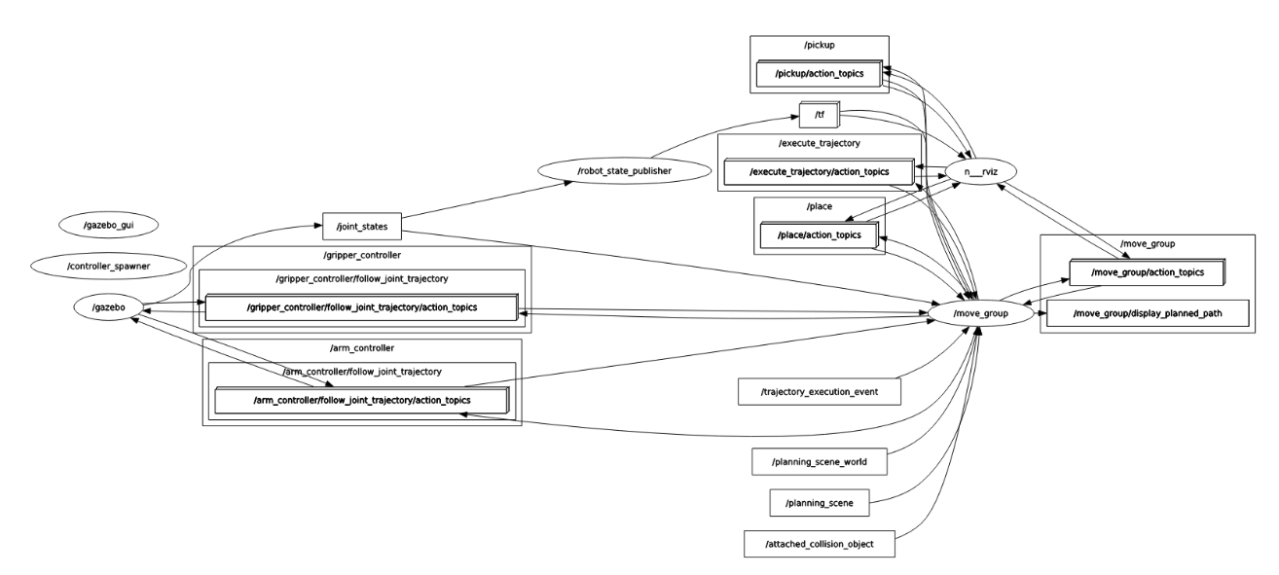
Rqt graph

Slide 24
Explanation
The above figure is the Ros node graph of our simulation. We have used The Move Group interface is a collection of APIs to access the various capabilities of the move group ROS node of Move It. For our project we have two robotic arm groups named robotic arm and a gripper.
Trajectories are executed on simulated robots or real hardware, and they are controlled by controllers. Gazebo uses controllers to control the motion and to know the poses and status of the robot.
Gazebo uses the JointStateController to publish current joint values and JointTrajectoryController to control the execution of trajectories. . Communication between all these components happens over ROS topics and action servers.
Trajectory controllers contain a name, a type, a list of associated joints, the gains, their constraints, and some other information to do with tolerances. Controllers are provided as ROS action servers, and they need to be powered by nodes. We can launch them using launch files.

Slide 25
RRT(Rapidly exploring random trees) Algorithm
First, we’ll initialize an empty tree. Next, we’ll insert the root node that represents the start position into the tree. At this point, we’ll just have a tree with a single node that represents the start position. Finally, we’ll repeat these steps until we hit the number of iterations or reach the goal, whichever one comes first.
Parameters of RRT
Map: the map of the environment that’s partitioned into an obstacle region and an obstacle-free region.
Start Position: the start position of the robot in its environment.
Goal Region: the goal region of the robot in its environment.
Number of Iterations: the number of iterations performed by RRT.

Slide 26
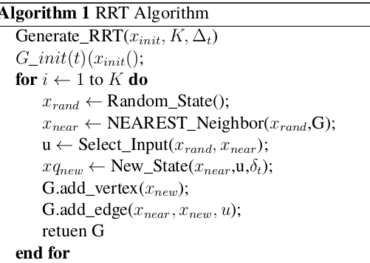
RRT Algorithm

Slide 27
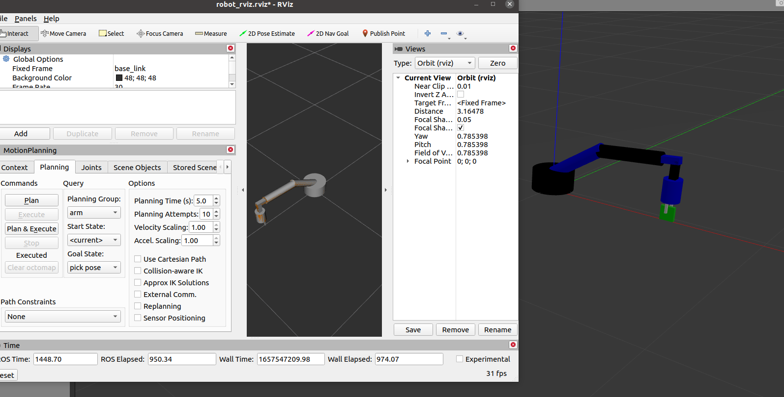
Pick Pose

Slide 28
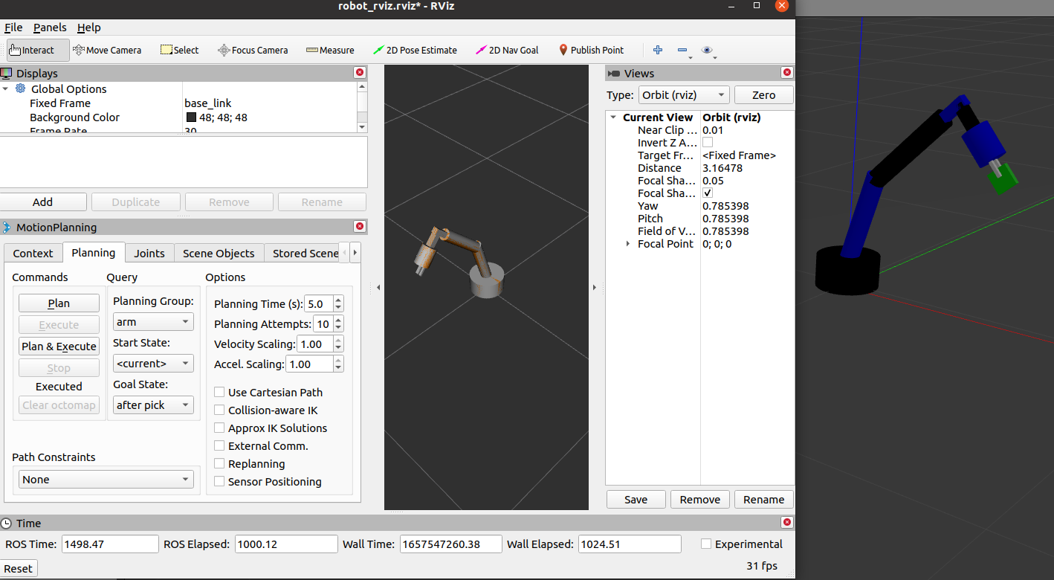
After Pick Pose

Slide 29
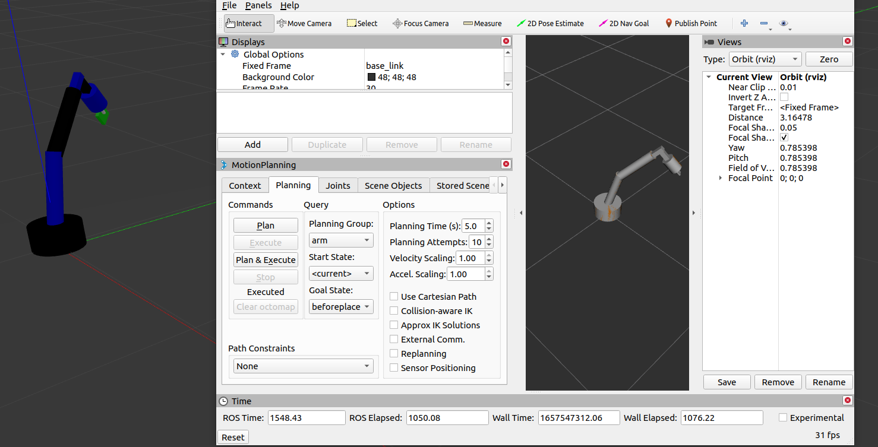
Before Place Pose

Slide 30
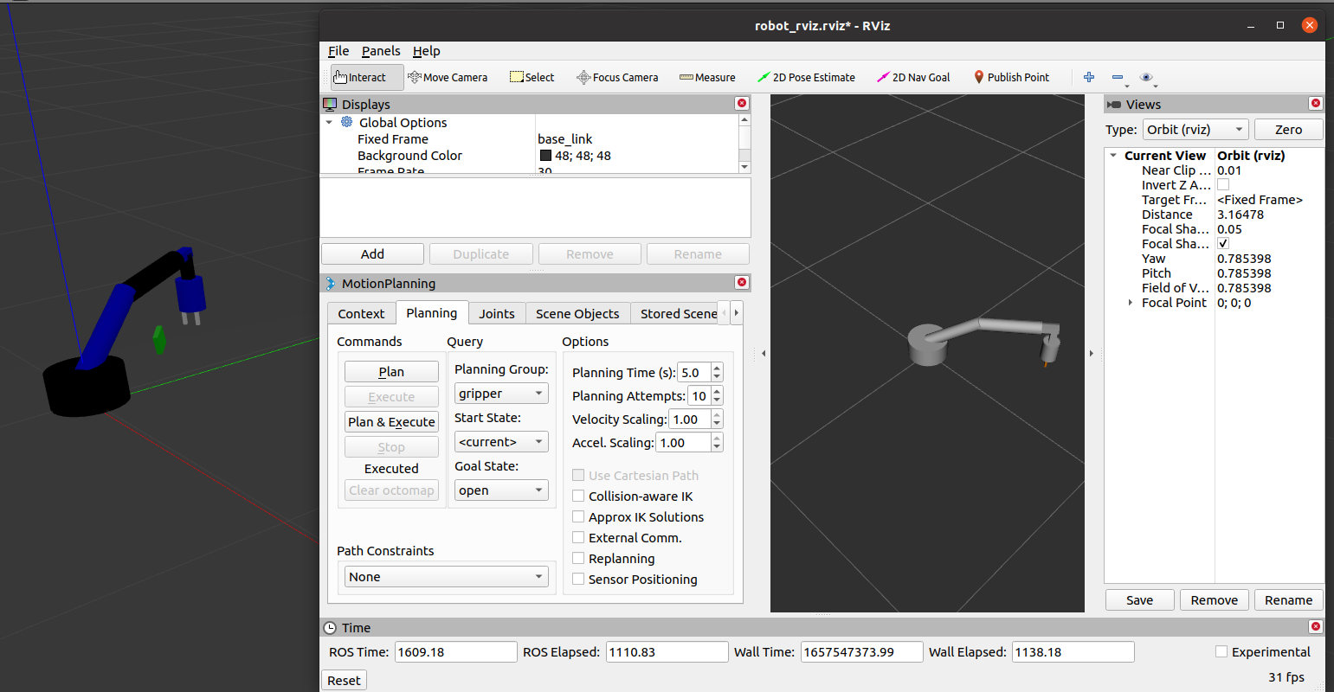
Place Pose

Slide 31

Simulation

Slide 32

Simulation

Slide 33

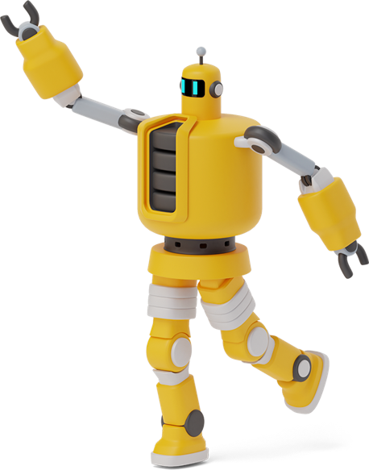
THANK YOU
Thanks!

